Slide 1
Gospel of Mark
Part II
Mystery of Jesus
Jesus’ public ministry begins:
He Calls his disciples:
Appoints the apostles.
Ascension Men’s Bible Study

Slide 2
Review
John the Baptist – authenticated and his ministry
Baptism of Jesus
Announcement of the Holy Trinity
Meaning of “Gospel of Jesus Christ”
Two Titles of Jesus “Christ” – “Son of God”
Sacrament
Significance of the Baptism of Jesus and how it sets the model for our Catholic baptism

Slide 3
Gospel - Good News of God
First title – Christ – the Anointed One.
Second title - Son of God – Jesus is proclaimed by God himself as His Son.
Sacrament – “An effective sign of grace, instituted by Christ and entrusted to the Church, by which divine life is dispensed to us by the work of the Holy Spirit”. CCC 1131, 774

Slide 4
Rite of Baptism
‘What takes place during the Catholic Rite of Baptism?
‘What took place during the Baptism of Christ?
Communal setting
Parents are present
Joy expressed for the gift of the child
Obedience to God is expressed
Gospel is witnessed to
Evil (Satan) is cast out
Repentance and forgiveness take place
The water is blessed
Announcement proclaimed as “Child of God
Promises made to raise child to know and obey God – leads to confirmation
The child is anointed with Chrism oil representing the Holy Spirit entering its life. At confirmation the child receives the gift of the Holy Spirit.
Held in public setting
God in the form of the trinity was present
God expressed his joy in his Son
Jesus is fulfilling the Covenant promise
Scriptures are fulfilled
Baptism for Repentance
Jesus identifies with sinners
Jordan River – blessed place of deliverance
God announces “You are my beloved Son; with you I am well pleased”
Jesus is led by the Spirit into the wilderness to be tempted – preparing for his ministry
The Holy Spirit descended upon him as a Dove

Slide 5
Word Study
Disciple
Apostle
Ordination
Presbyter
Magisterium

Slide 6
John was arrested
Read Mark 1: 14-15 PAGE 1403
Pivotal event
  Prior to this Jesus’ ministry was like John’s
  Now the ministry he was sent for begins
Jesus’ ministry changes from one similar to John’s (John 3:23-30 page 1494) to one emphasizing believing in the gospel – the good news.

Slide 7
Jesus “public ministry”
Jesus public ministry falls into a few categories:
Calling his disciples
  Appointing apostles
  Commissioning/Ordaining the apostles
    Giving them authority
    Establishing the church Magisterium
Training his disciples
  Healing and miracles
  Authority over demons
  Teachings

Slide 8
Jesus “calls” his first disciples
If you were starting a new movement what would be the qualifications you would want in your core leadership group?
Read Mark 1: 16-20 page 1403
First Four:
  Simon
  Andrew
  James
  John
Why do you suppose Jesus chose them?
  Fishermen – Common ordinary people
  Businessmen – Successful employers
  Not part of the opposition – the Sadducees or the Pharisees
  Financially stable/well off perhaps

Slide 9
Jesus “calls” Levi (Matthew)
Read Mark 2: 13-17 page 1404 and Matthew 9:9-10 page 1350
Levi in Mark is known as Matthew in other gospels.
  What do we know of Matthew?
    Tax Collector – worked for the Roman Government
    Outcast from Jewish Society
    Regarded as a “sinner” by the Jews

Slide 10
Jesus appoints the Twelve
Up to this point Jesus has called “disciples”.
Who/what is a disciple?
  Page 1786 – a follower, an adherant of a particular teaching
When Jesus is teaching his disciples, he is also teaching us because we are also his disciples. Any instruction he gives to them he is also giving to us

Slide 11
Jesus appoints the Twelve Apostles
Apostle defined – glossary page 1782
  After Judas died, the eleven found it necessary to replace him. Why?
  What qualifications were needed by the one selected?
  Acts 1:21-26 page 1528

Slide 12
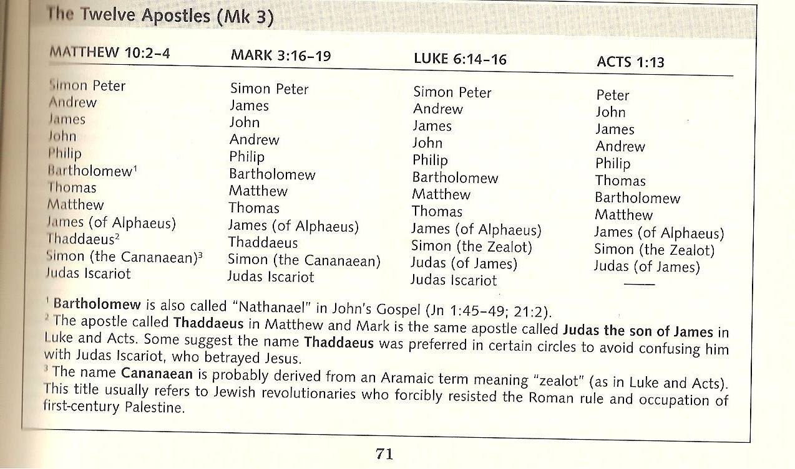
Jesus appoints the Twelve (continued)
Read Mark 3: 13-19 page 1406
The 12 are named in 3 gospels and Acts
  Matthew 10:2-4, Mark 3:16-19, Luke 6:14-16, Acts 1:13

Slide 13
What was the mission of the Apostles
Read Mark 6:7-13 page 1410
  Authority over unclean spirits
  Preach repentance
  Anointed the sick with oil of healing
Read Matthew 28:16-20 page 1399
  Baptize in name of Father, Son, and Holy Spirit
  Teach all that Jesus has commanded them.
Entrusting their office to successors –Apostolic succession -
Read Acts 14:23, 15:1-12 ( note versus 2, 4, 6) page 1552
  Apostles and Presbyters
    Bishops
    Priests

Slide 14
Apostolic Succession
CCC-1087 Thus the risen Christ, by giving the Holy Spirit to the apostles, entrusted to them his power of sanctifying: they became sacramental signs of Christ. By the power of the same Holy Spirit they entrusted this power to their successors. This "apostolic succession" structures the whole liturgical life of the Church and is itself sacramental, handed on by the sacrament of Holy Orders.

Slide 15
Paul, Barnabas,
Read Acts 13:1-3 page 1548
First Apostolic Succession
  Set apart Paul and Barnabas by laying on of hands
  Sent out by the Holy Spirit
Paul called an Apostle – Galatians 1:1 page 1644
In our Roman Catholic tradition, what is the Sacrament through which Apostolic Succession is implemented?

Slide 16
Holy Orders
CCC 1536 Holy Orders is the sacrament through which the mission entrusted by Christ to his apostles continues to be exercised in the Church until the end of time: thus it is the sacrament of apostolic ministry. It includes three degrees: episcopate, presbyterate, and diaconate
The Episcopate is composed of our Bishops (regional pastors) and the Presbyterate is composed of our Priests (Parish pastors).
CCC 2179 "A parish is a definite community of the Christian faithful established on a stable basis within a particular church; the pastoral care of the parish is entrusted to a pastor as its own shepherd under the authority of the diocesan bishop." It is the place where all the faithful can be gathered together for the Sunday celebration of the Eucharist. The parish initiates the Christian people into the ordinary expression of the liturgical life: it gathers them together in this celebration; it teaches Christ's saving doctrine; it practices the charity of the Lord in good works and brotherly love:

Slide 17
Members of the Apostolic Succession
Pope – Pastor of the global church – Apostle – successor to Peter
  Bishops – Pastors of regional (diocesan) churches
    Priests – Pastors of the parish churches
      Deacons

Slide 18
Role of Magisterium
The role of the members of the Magisterium are illustrated for us in Acts 15:1-22 page 1552
  Paul and Barnabas bring issue to the Apostles and Presbyters (Magisterium)
  Peter – whom we consider the first Pope – made decision and pronounced it to the Apostles and Presbyters
  James, a Bishop – prepared a plan of action
  Bishops, Paul and Barnabas, with Presbyters delivered the proclamation to the church

Slide 19
Next Month
We will use chapters 1:14 – 8:26 again.
Emphasis will be on Christ’s teaching to us his disciples looking at:
Miracles
Parables
Confrontation with Pharisees and Sadducees

